Slide 1
Credit Card Fraud Detection Team F
Sadasiva Madhav Nimmagadda( IQ36495)
Varsada Anjali Rameshchandra ( LF78371)
Kiran Kumar Reddy Guggilla ( DE14051)

Slide 2
Introduction
Credit card fraud is a widespread issue with far-reaching consequences. Every year, billions of dollars are lost due to fraudulent transactions, impacting both individuals and financial institutions. This project addresses this pressing concern by harnessing the power of data science and machine learning.
The primary goal of this project is to construct an effective Credit Card Transactions Fraud Detection system. This system comprises several key objectives:
1)Data preprocessing 2)Model selection 3)Real time prediction 4)Enhanced security and reduced losses.

Slide 3
Agenda
Descriptive Analysis of the Credit Card data
Data Preprocessing and Visualization
Identifying patterns using EDA
Feature Engineering
Hypothesis Testing
Balancing the Classes by Oversampling using SMOTE
Implementing ML models and Assessing the performance
Comparing PCA and Non PCA data performance

Slide 4
Data Overview
The dataset contains transactions of a simulated credit card transaction dataset containing legitimate and fraud transactions from the duration 1st Jan 2019 - 31st Dec 2020.
It covers credit cards of 1000 customers doing transactions with a pool of 800 merchants.
There are a total of 1296675 transactions and 23 columns
This data generated using Sparkov Data Generation This simulation was run for the duration - 1 Jan 2019 to 31 Dec 2020. The files were combined and converted into a standard format.
Source : Kaggle
New Dataset: https://www.kaggle.com/datasets/kartik2112/fraud-detection/data
Features:
Unnamed, trans_date_trans_time, 'cc_num', 'merchant', 'category', 'amt', 'first', 'last', 'gender', 'street', 'city', 'state', 'zip', 'lat', 'long', 'city_pop', 'job', 'trans_num', 'unix_time', 'merch_lat', 'merch_long', 'is_fraud',
Target: is_fraud

Slide 5
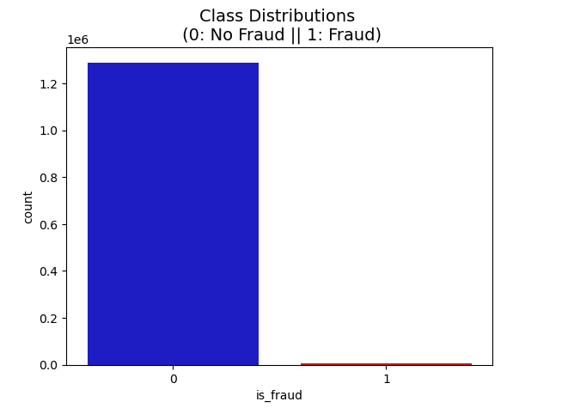
Data Distribution
The dataset is very imbalanced with around 1289169 positive class (99.42%) and 7506 (0.58%) negative class.
Our objective to achieve binary classification to determine whether a transaction is either fraud or not fraud.

Slide 6
Literature Research
Title: "Credit Card Fraud Detection: A Realistic Modeling and a Novel Learning Strategy"
Authors: Wen-Chih Peng, Kuo-Yi Lin, Hsiao-Fan Wang, and Chia-Hung Lin
Summary: This paper presents a comprehensive approach to credit card fraud detection, including feature engineering and a novel learning strategy based on multiple models.
Title: "Deep Learning for Credit Card Fraud Detection"
Authors: Andrej Beznosov, Viktor Beznosov
Summary: This research explores the application of deep learning techniques, specifically convolutional neural networks (CNNs) and recurrent neural networks (RNNs), for credit card fraud detection.
Title: "Credit Card Fraud Detection Using Machine Learning Techniques: A Survey"
Authors: Snehanshu Saha, Shikhar Srivastava, Prerna Mahajan, and Abhinav Suman
Summary: This survey paper provides an overview of various machine learning techniques applied to credit card fraud detection, highlighting the strengths and weaknesses of each approach.

Slide 7

Github Repository
https://github.com/Data-606-Kiran/Capstone_Project

Slide 8
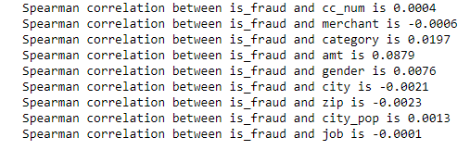
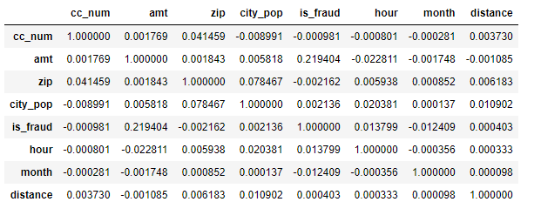
Correlation

Slide 9
Exploratory Data Analysis

Slide 10
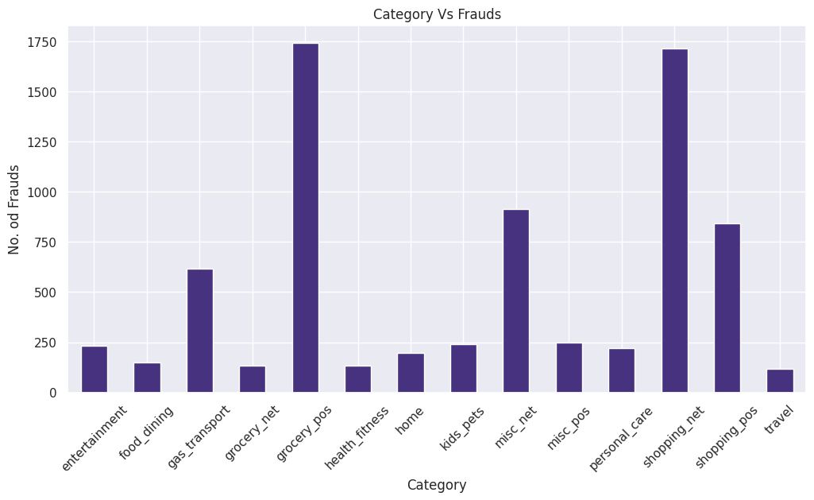
Category Vs Fraud

Slide 11
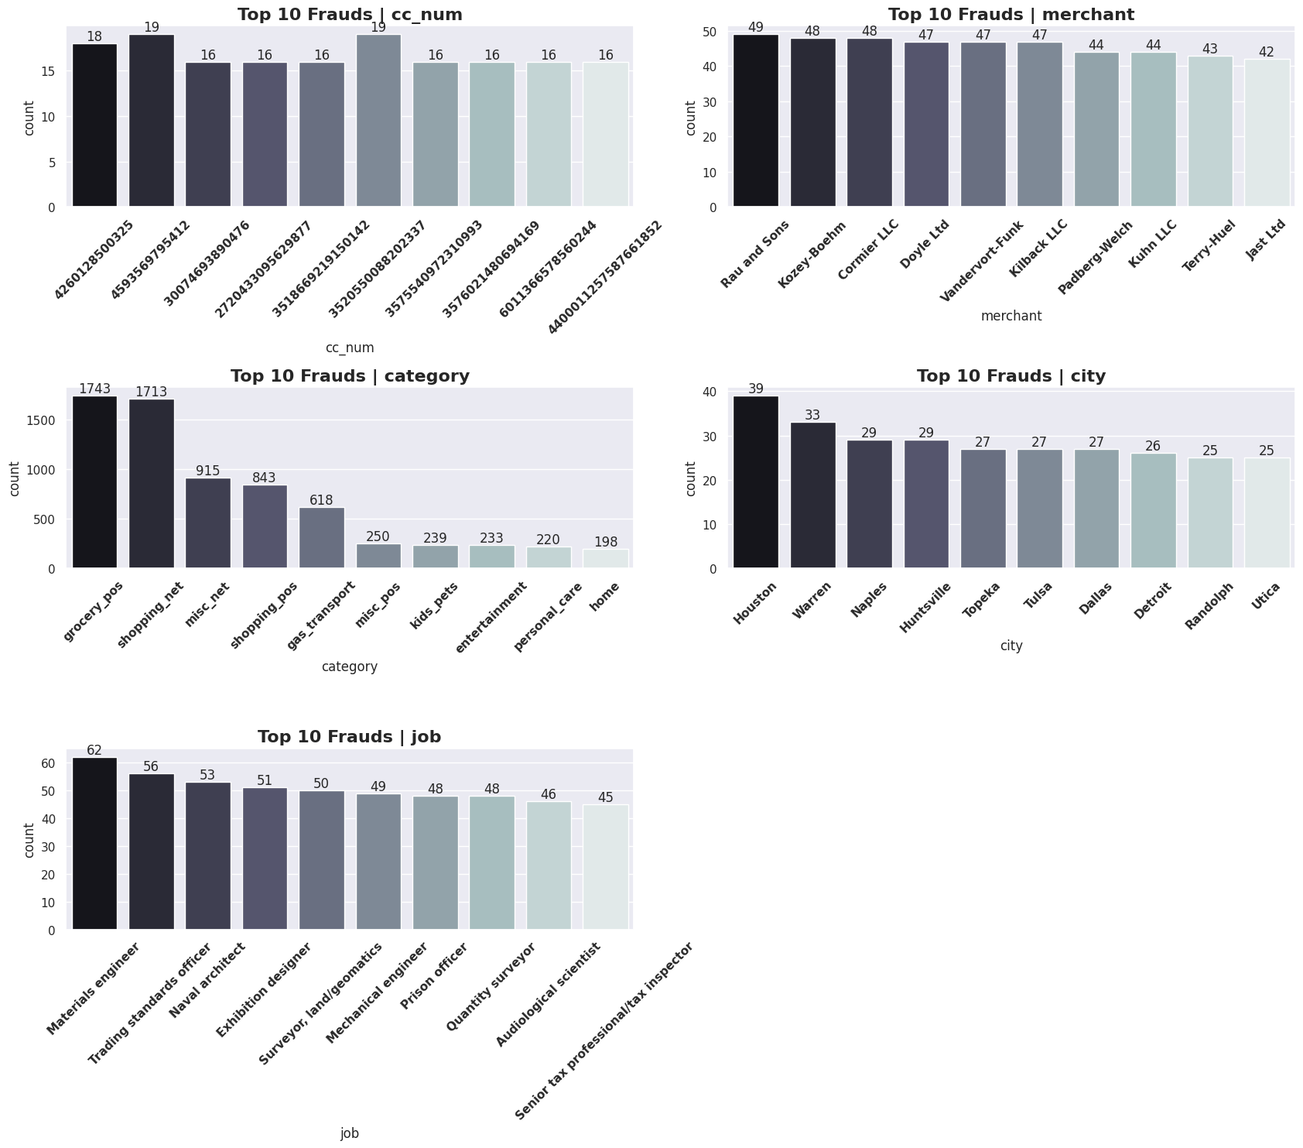

Slide 12
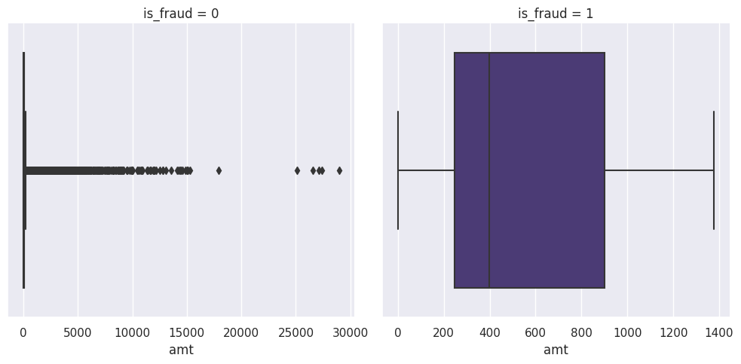
Outliers in the Target

Slide 13
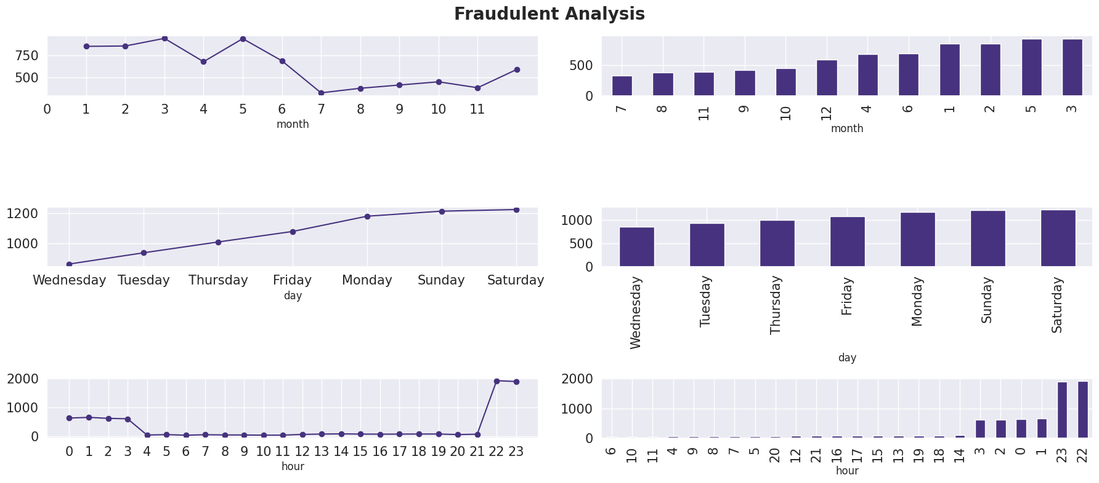
Fraud vs Day, Time and Month

Slide 14
Hypothesis Testing

Slide 15
Transaction Amount Analysis
Null Hypothesis: The null hypothesis (H0) is that there is no significant difference in the average transaction amount between fraudulent and non-fraudulent transactions.
Alternate Hypothesis: The alternate hypothesis (H1) is that there is a significant difference in the average transaction amount between fraudulent and non-fraudulent transactions.
p value: 0.0
p value is smaller than significance level. We reject Null Hypothesis.
Conclusion:
The hypothesis test indicates that the mean transaction amounts are significantly different between fraudulent and non-fraudulent transactions, providing a potential characteristic to consider in predictive modeling.

Slide 16
Significance of City Population on Fraud
Null hypothesis (H0): States that there is does help us on the target
Alternate hypothesis (H1): states that city_population does not help us on the target(is_fraud)
p value - 0.015 < 0.05
Reject Null Hypothesis
City Population does not have any effect on Fraudulent Transactions

Slide 17
Model Performance with Imbalanced Dataset
Model | Accuracy | Precision | Recall | F1 Score
Logistic Regression | 0.8597 | 0.51 | 0.79 | 0.86
Random Forest | 0.94 | 0.50 | 0.51 | 0.95
SVM | 0.9935 | 0.50 | 0.50 | 0.99
KNN | 0.9939 | 0.50 | 0.50 | 0.99

Slide 18
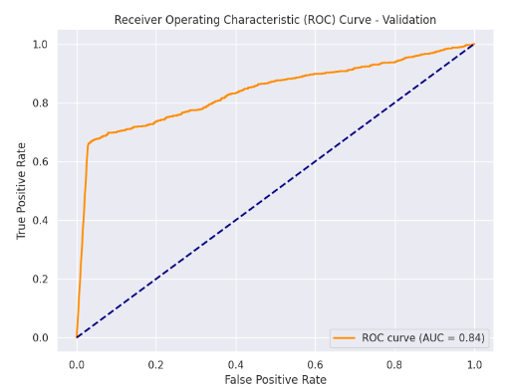
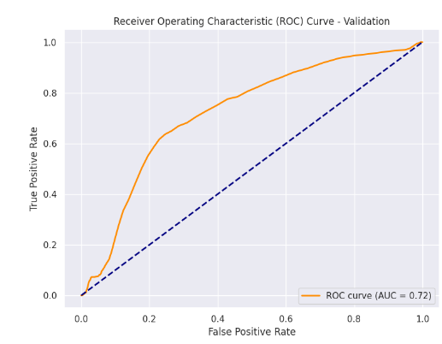
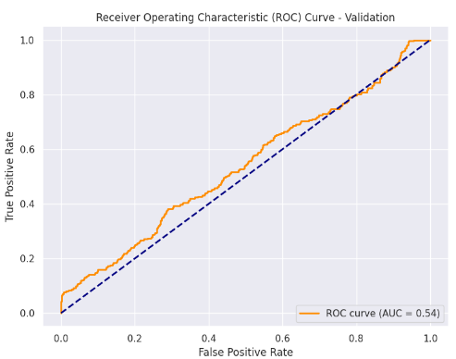
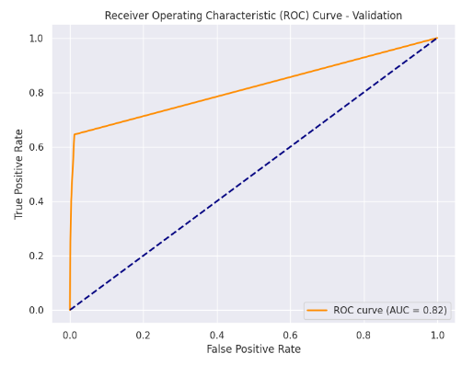
Logistic Regression
Random Forest
SVM Classifier
KNN

Slide 19
Principal Component Analysis

Slide 20
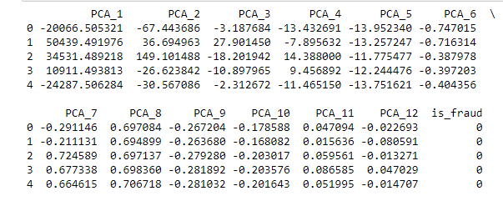
PCA Columns

Slide 21
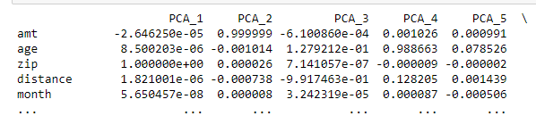
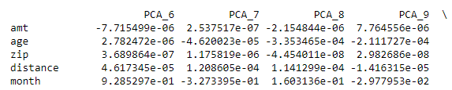
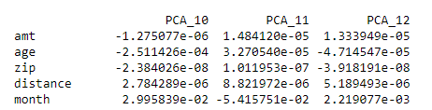
PCA Attribute Matching with Weights

Slide 22
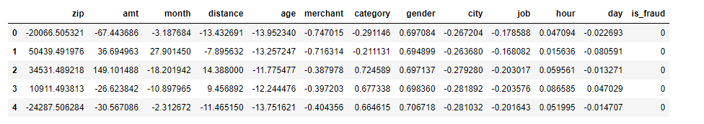
Transformed Columns after Attribute Matching

Slide 23
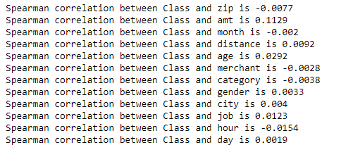
Spearman Rank Correlation for PCA

Slide 24
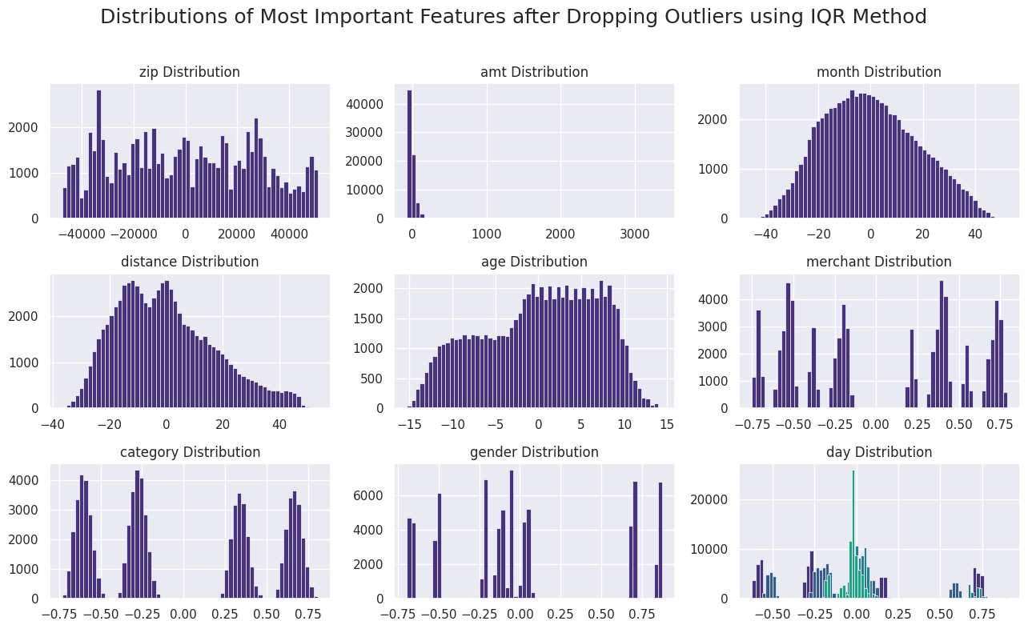
Distribution of Feature after dropping Outliers

Slide 25
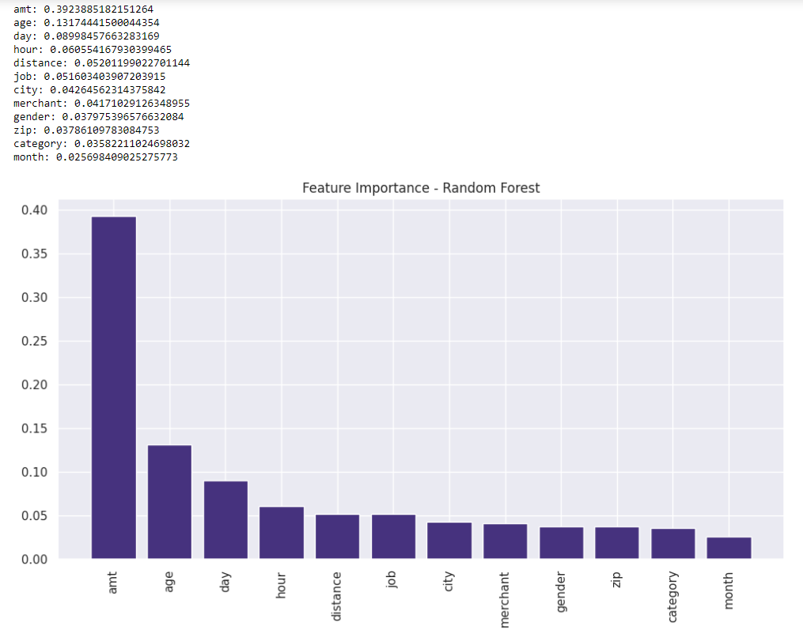
Random Forest Feature Importance

Slide 26
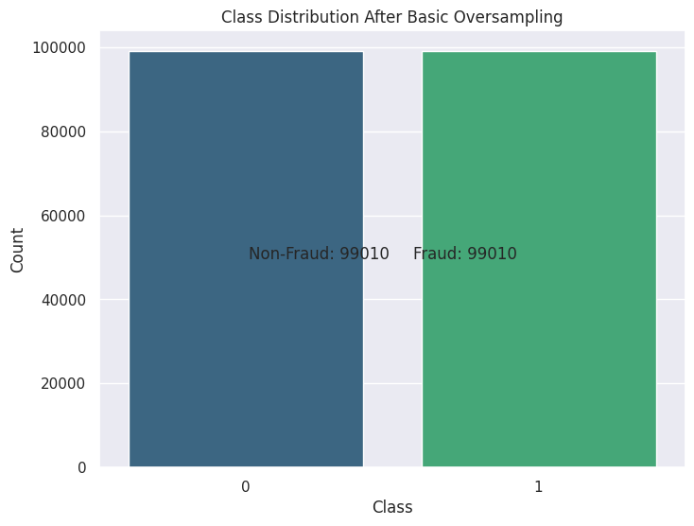
Class Distribution after SMOTE Oversampling

Slide 27
PCA Model Performance
Model | Accuracy | Precision | Recall | F1 Score | ROC- AUC
Logistic | 0.84 | 0.937 | 0.749 | 0.832 | 0.8494
Random Forest | 1.00 | 1.00 | 1.00 | 1.00 | 1.00
SVM | 0.8071 | 0.9690 | 0.6344 | 0.7668 | 0.8071
KNN | 0.9968 | 0.9936 | 1.000 | 0.9968 | 0.9968
Gradient Boosting | 0.9553 | 0.9533 | 0.9575 | 0.9554 | 0.9553

Slide 28
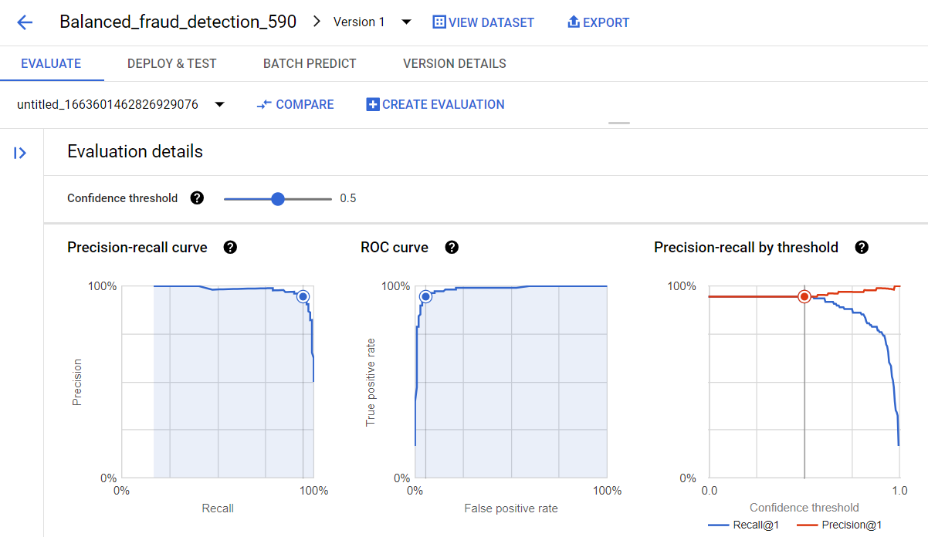
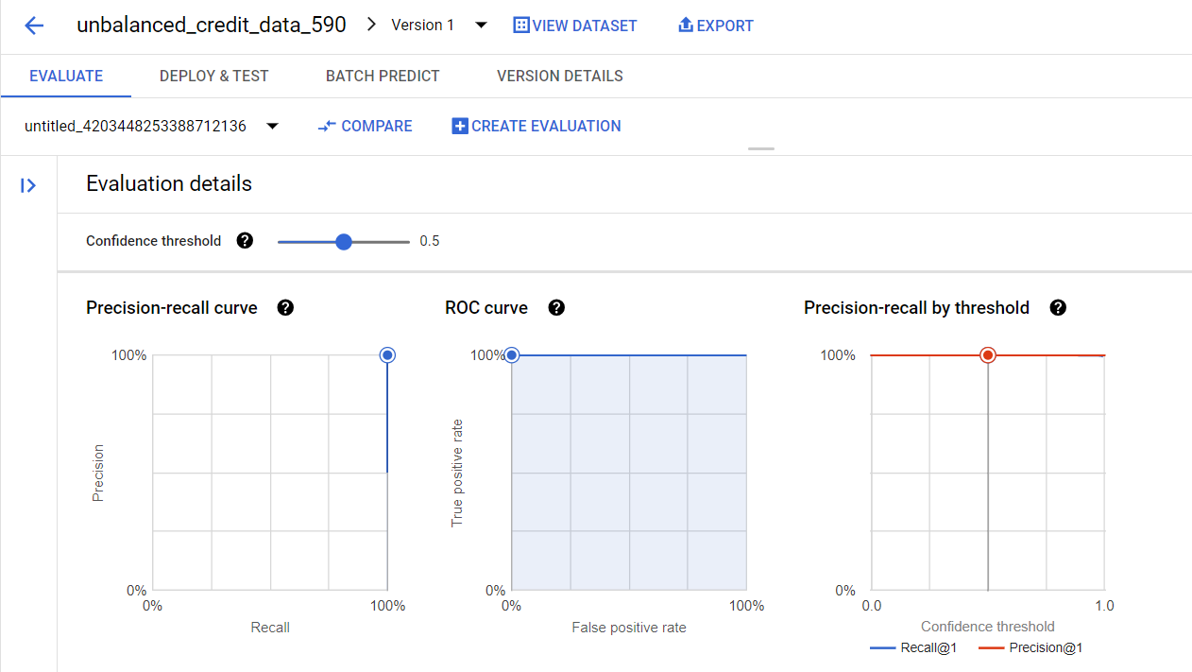
Feature Importance on GCP

Slide 29
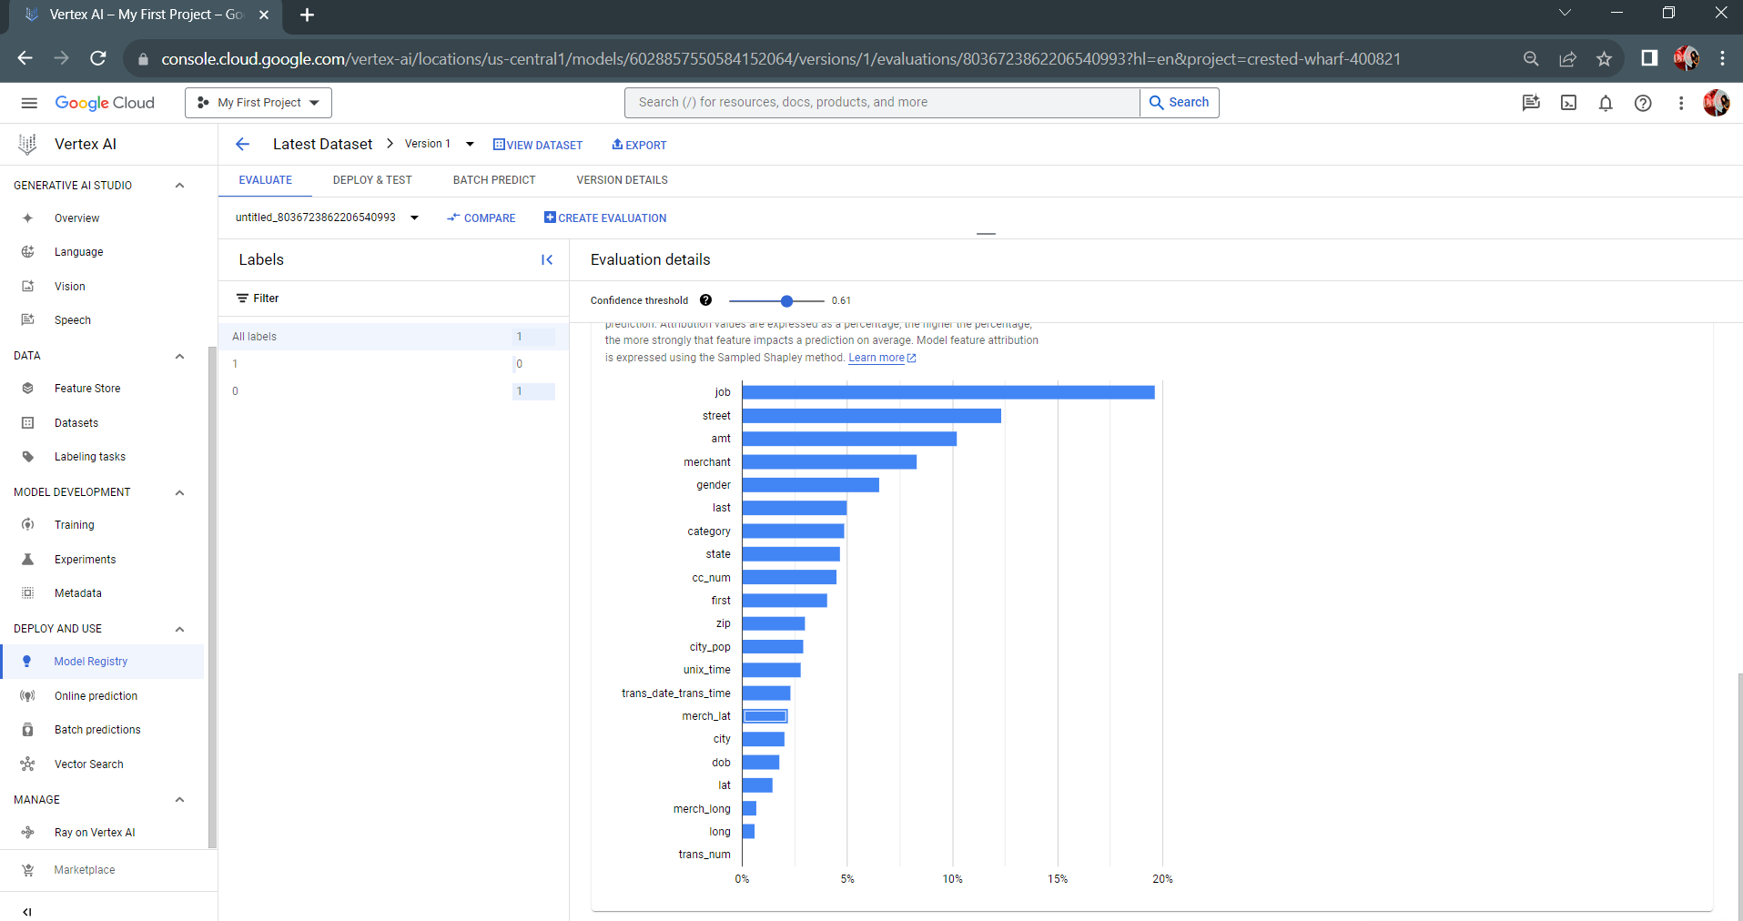
Feature Importance on GCP

Slide 30
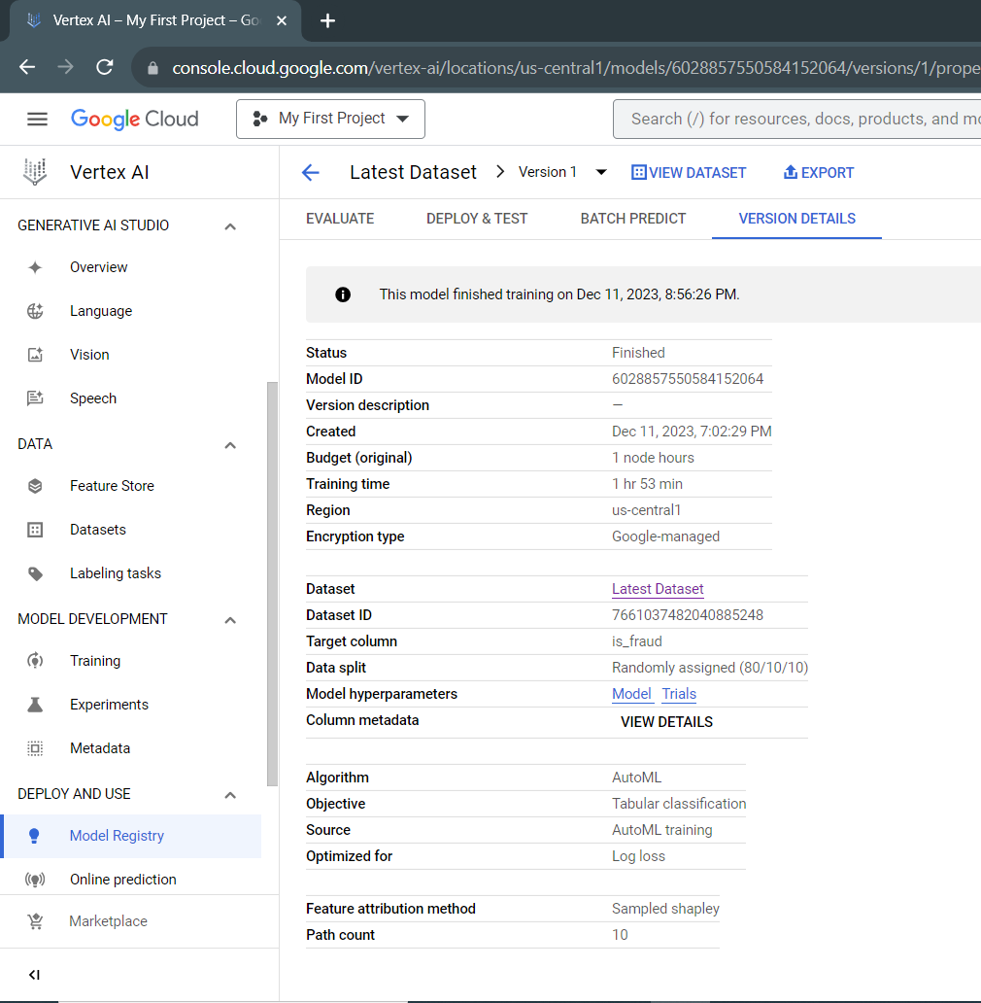
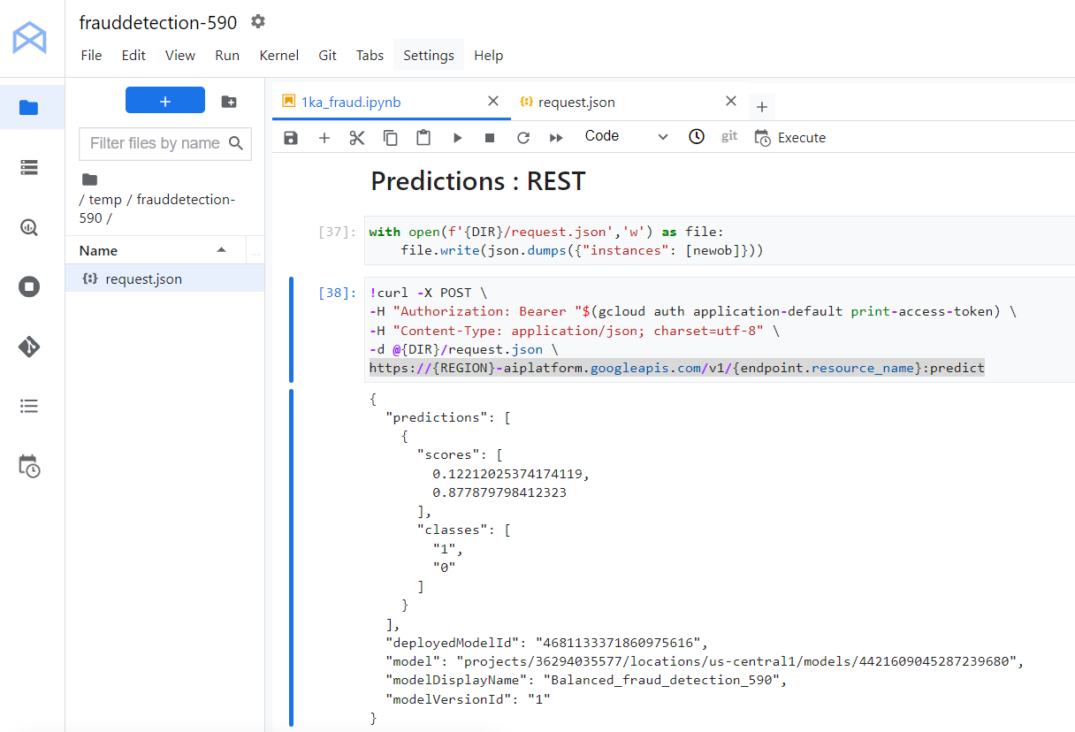
Feature Importance on GCP

Slide 31
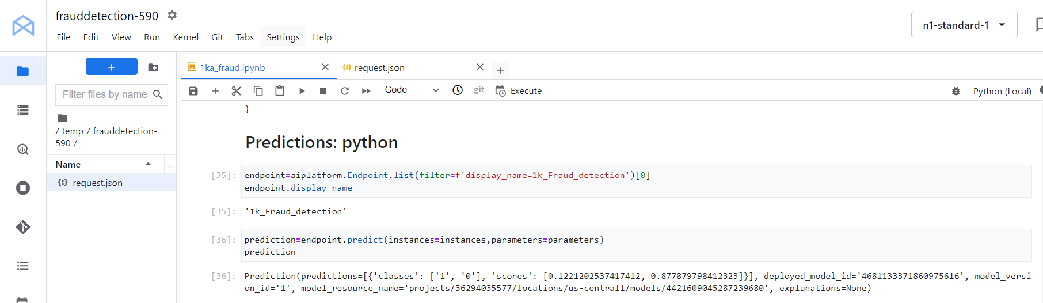
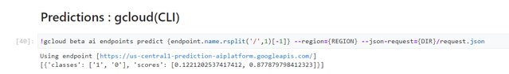
Prediction of Fraud/ Not Fraud GCP

Slide 32
Thank you !
Q&A

